Slide 1
Machine Learning
Lesson 1: Introduction to Artificial Intelligence and
Machine Learning

Slide 2


Concepts Covered
Machine Learning Techniques
Applications of Machine learning

Slide 3
Define Artificial Intelligence (AI) and understand its relationship with data
Define Machine Learning (ML) and understand its relationship with artificial intelligence and data science
Understand machine learning approach
Identify the applications of machine learning

Slide 4
Introduction to Artificial Intelligence and Machine Learning
Topic 1: Emergence of Artificial Intelligence

Slide 5
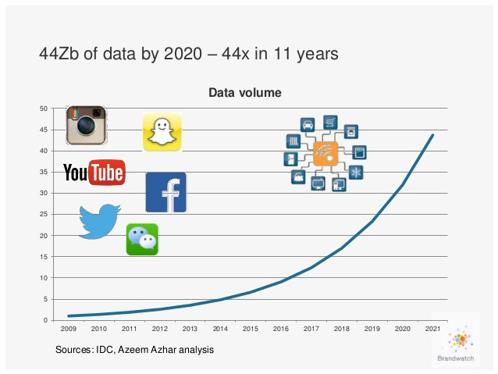
Data Economy
Explosion of data has given rise to a new economy and there is a constant battle for ownership of data between enterprises to derive benefits from it.

Slide 6
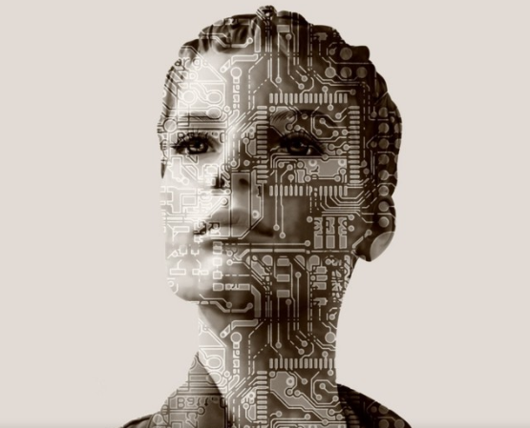
Emergence of Artificial Intelligence
Science associated with data is going toward a new paradigm where one can teach machines to learn from data and derive a variety of useful insights giving rise to Artificial Intelligence.

Slide 7


Definition of Artificial Intelligence
Artificial Intelligence refers to intelligence displayed by machines that simulates human and animal intelligence.
Notes:
Trainer notes:
It involves ‘intelligence agents’, the autonomous entities that perceive its environment and take actions that maximize its chance of success at a given goal.

Slide 8
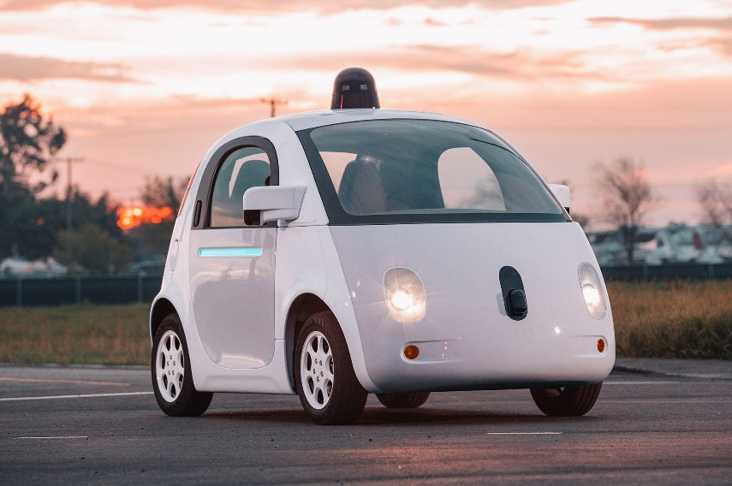

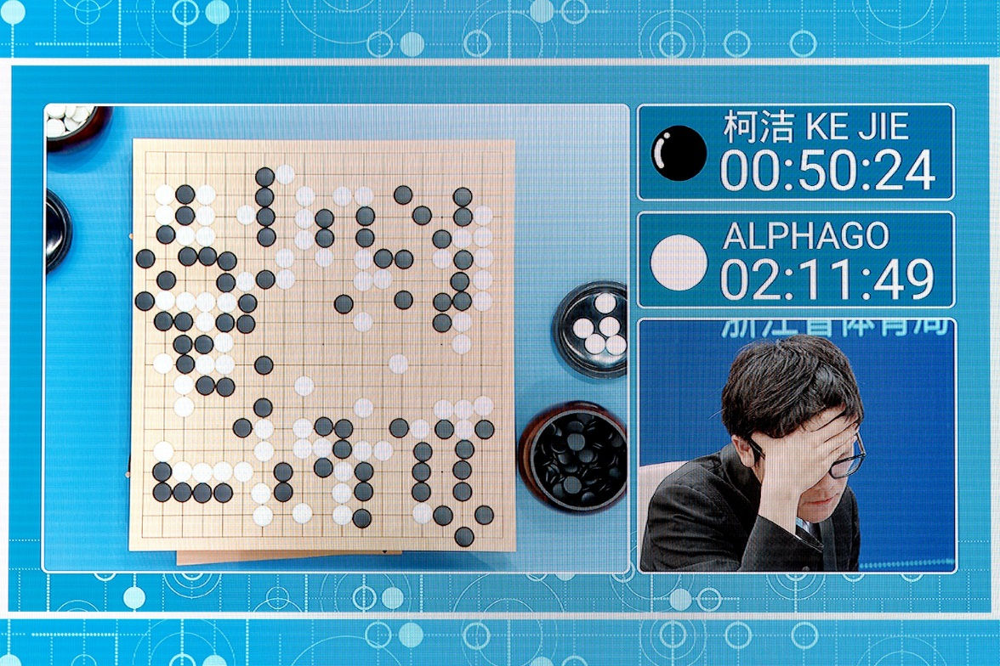
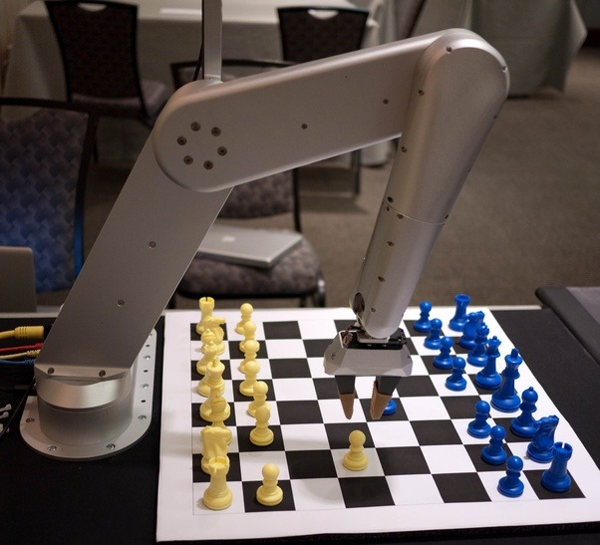


Artificial Intelligence in Practice
AI is redefining industries by providing greater personalization to users and automating processes.
Self-driving cars
Siri(iPhone)
Google’s AlphaGo
Chess
Amazon ECHO
Concierge robot from IBM Watson
Sources: documentarytube, wired, Quora

Slide 9



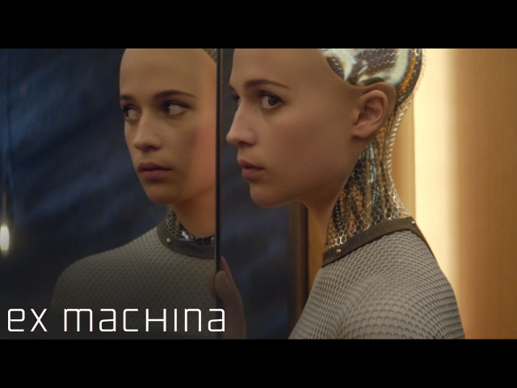


Sci-Fi Movies with the Concept of AI
Few AI films spanned through the decades that reflect the everchanging spectrum of our emotions regarding the machines we have created

Slide 10


Data Facilitates in Recommendations
Amazon collects data from users and recommends the best products according to the user's buying/shopping pattern.

Slide 11
Introduction to Artificial Intelligence and Machine Learning
Topic 2: Relationship between AI, ML, and Data Science

Slide 12
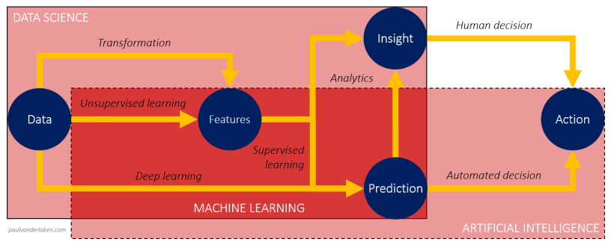
Relationship between Artificial Intelligence, Machine Learning, and Data Science
Even though the terms data science, machine learning, and artificial intelligence (AI) fall in the same domain and are connected to each other, they have their specific applications and meaning.
Notes:
Trainer notes:
Explain the relation between AI, Machine Learning and Data Science

Slide 13
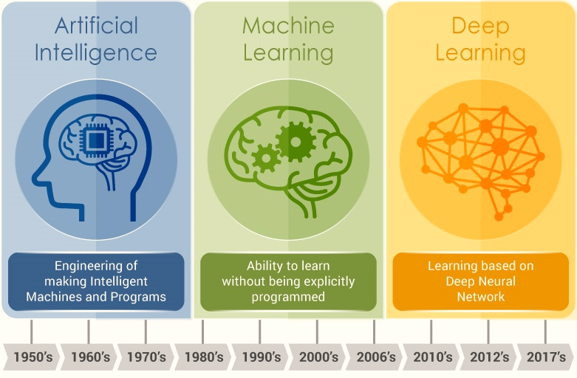
Relationship between Artificial Intelligence and Machine Learning
Machine Learning is an approach or subset of Artificial Intelligence that is based on the idea that machines can be given access to data along with the ability to learn from it.
Notes:
ML allows machines to gain intelligence, thereby enabling AI. Deep learning is a specialized form of ML where one can learn complex representations is the data by use of layered computational units called neural networks

Slide 14
Definition of Machine Learning
The capability of Artificial Intelligence systems to learn by extracting patterns from data is known as Machine Learning.

Slide 15
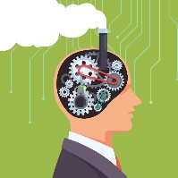


Features of Machine Learning
It uses the data to detect patterns in a dataset and adjust program
actions accordingly
01
It focuses on the development of
computer programs that can teach
themselves to grow and change
when exposed to new data
02
It enables computers to find hidden insights using iterative algorithms without being explicitly programmed
03
It automates
analytical model building
04

Slide 16
Introduction to Artificial Intelligence and Machine Learning
Topic 3: Machine Learning Approach

Slide 17







Traditional Approach vs. Machine Learning Approach
Traditional Programming: Data and program is run on the computer to produce the output
Machine Learning: Data and output is run on the computer to create a program
Data
Data
Model
Output
Program
Output

Slide 18
Traditional Approach
Traditional programming relies on hard-coded rules.
Production
Pass
Problem at hand
Code the Rules
Evaluate
Fail
Review errors
Notes:
Trainer notes:
Traditionally, one would hard-code the decision rules for a problem at hand, evaluate the results of the program and if the results were satisfactory, the program would be deployed in production. If results were not as expected, one would review the errors, change the program and evaluate it again.

Slide 19
Machine Learning Approach
Machine Learning relies on learning patterns based on sample data.
Training Data
Example: (x1, y1), (x2, y2)
Production
Pass
Problem at hand
Train ML algorithm
Evaluate
Fail
Review errors
Notes:
Trainer notes:
In the new Machine Learning approach, the decision rules are not hard-coded, rather the model is trained with training data to derive (or learn) the algorithm which represents the relation between the input and the output. This trained model is then evaluated against test data, and if the results are not satisfactory, the training is repeated with some changes.

Slide 20

Relationship between Machine Learning and Data Science
Data Science and Machine Learning go hand in hand. Data Science helps evaluate data for Machine Learning algorithms.

Slide 21


Relationship between Machine Learning and Data Science
Data science is the use of statistical methods to find patterns in the data.
Statistical machine learning uses the same math and techniques as data science.
These techniques are integrated into algorithms that learn and improve on their own.
Machine Learning facilitates Artificial Intelligence as it enables machines to learn from the patterns in data.

Slide 22
Machine Learning Techniques
Machine Learning uses a number of theories and techniques from Data Science:
Decision making
7
1
Classification
Visualization
6
Machine Learning
2
Categorization
Anomaly detection
5
3
Clustering
4
Trend analysis

Slide 23
Machine Learning Techniques
classification is a technique in which the computer program learns from the data input given to it and then uses this learning to classify new observation
Decision making
7
1
Classification
Visualization
6
Machine Learning
2
Categorization
Anomaly detection
5
3
Clustering
4
Trend analysis

Slide 24
Machine Learning Techniques
Decision making
7
1
Classification
Visualization
6
Machine Learning
2
Categorization
A technique of organizing data into categories for its most effective and efficient use.
Anomaly detection
5
3
Clustering
4
Trend analysis

Slide 25
Machine Learning Techniques
Decision making
7
1
Classification
Visualization
6
Machine Learning
2
Categorization
Anomaly detection
5
3
Clustering
Technique of grouping a set of objects in such a way that objects in the same group are more similar to each other than to those in other groups
4
Trend analysis

Slide 26
Machine Learning Techniques
Decision making
7
1
Classification
Visualization
6
Machine Learning
2
Categorization
Anomaly detection
5
3
Clustering
4
Trend Analysis is a technique aimed at projecting both current and future movement of events through use of time series data analysis
Trend analysis

Slide 27
Machine Learning Techniques
Decision making
7
1
Classification
Visualization
6
Machine Learning
2
Categorization
Anomaly detection
5
3
Clustering
Anomaly detection is a technique to identify cases that are unusual within data that is seemingly homogeneous
4
Trend analysis

Slide 28
Machine Learning Techniques
Technique to present data in a pictorial or graphical format. It enables decision makers to see analytics presented visually
Decision making
7
1
Classification
Visualization
6
Machine Learning
2
Categorization
Anomaly detection
5
3
Clustering
4
Trend analysis

Slide 29
Machine Learning Techniques
A technique/skill which provides you with the ability to influence managerial decisions with data as evidence for those possibilities
Decision making
7
1
Classification
Visualization
6
Machine Learning
2
Categorization
Anomaly detection
5
3
Clustering
4
Trend analysis

Slide 30
Introduction to Artificial Intelligence and Machine Learning
Topic 4: Applications of Machine Learning

Slide 31

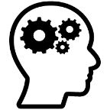

Applications of Machine Learning
Artificial intelligence and Machine learning are being increasingly used in various functions such as:
Image Processing
Healthcare
Robotics
ML
Text Analysis
Data Mining
Video Games

Slide 32
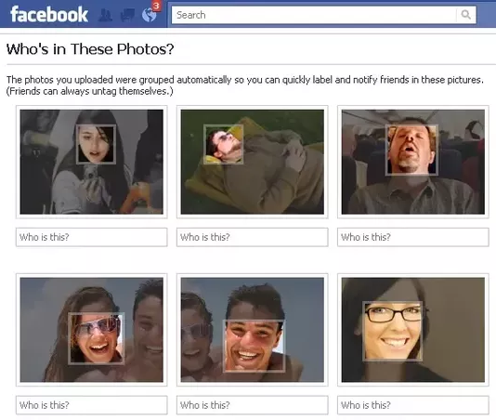
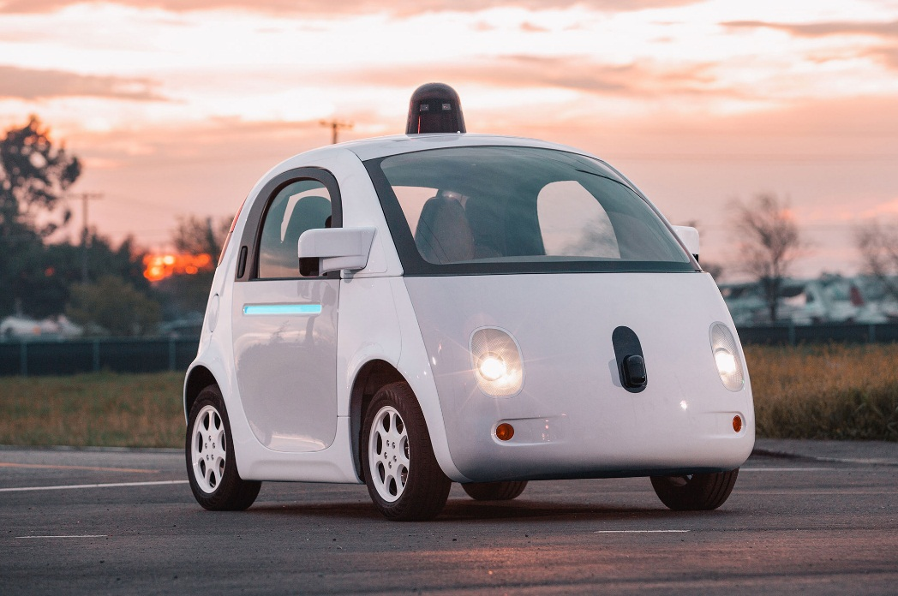
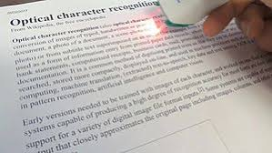
Applications of Machine Learning
Image Processing
ML
Image tagging and recognition
Self-driving cars
Optical Character Recognition (OCR)
Sources: Quora, documentarytube, Wikipedia
Notes:
Trainer notes:
Examples of image processing:
1. Automatic Facebook face tagging - Learns from user-tagged photos
2. OCR - Scan printed docs to digitize the text, Character recognition
3. Self-driving cars - Cars are taught to drive themselves, Algorithm learns by observing video frames of driving cars (and recognizing images of obstacles, signs and other traffic)

Slide 33
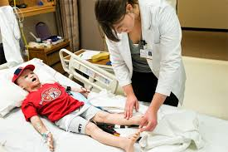
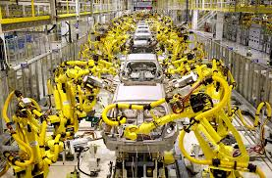
Applications of Machine Learning
Robotics
Human simulation
ML
Humanoid Robot
Industrial robotics
Sources: uiowa.edu, LinkedIn, Hilton

Slide 34
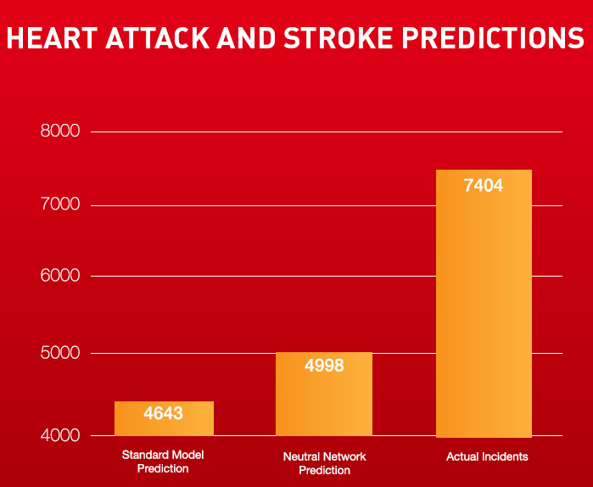

Applications of Machine Learning
Anomaly detection
Grouping and Predictions
ML
Data Mining
Association rules
Sources: dbta, Futurism
Notes:
Trainer notes:
Examples of Data Mining:
1. Anomaly detection - Detect outliers; detect credit card fraud detection – to determine which transactions vary from usual purchase patterns
2. Association rules - Also called market basket analysis – detect which items seem to occur together; chalk and duster are often bought together
3. Grouping - classify users based on their profiles, middle income or high income; classify high risk diabetes patients
4. Predictions - Predict credit scores by learning from profiles and scores of older customers; Health risk scoring based on learning from health conditions of prior customers

Slide 35

Applications of Machine Learning
ML
Some games implement reinforcement learning
Video Games
Sources: Quora
Notes:
Trainer notes:
Examples of Video games:
Game character or robot is trained to move within an environment avoiding obstacles or enemies; May use a technique called Reinforcement Learning - train the character or robot by rewarding an “incentive” for the right moves and “penalty” for the wrong moves

Slide 36
Applications of Machine Learning
Sentiment Analysis
Spam Filtering
Information Extraction
ML
Text Analysis
Notes:
Trainer notes:
Examples of text analysis:
Spam filtering - Learn to detect spam in emails and other communication
Sentiment Analysis - Learn to classify an opinion as positive, negative or neutral; detect public sentiment in twitter feed or filter customer complaints
Information extraction - Extract specific information or data addresses, keyword or entities

Slide 37
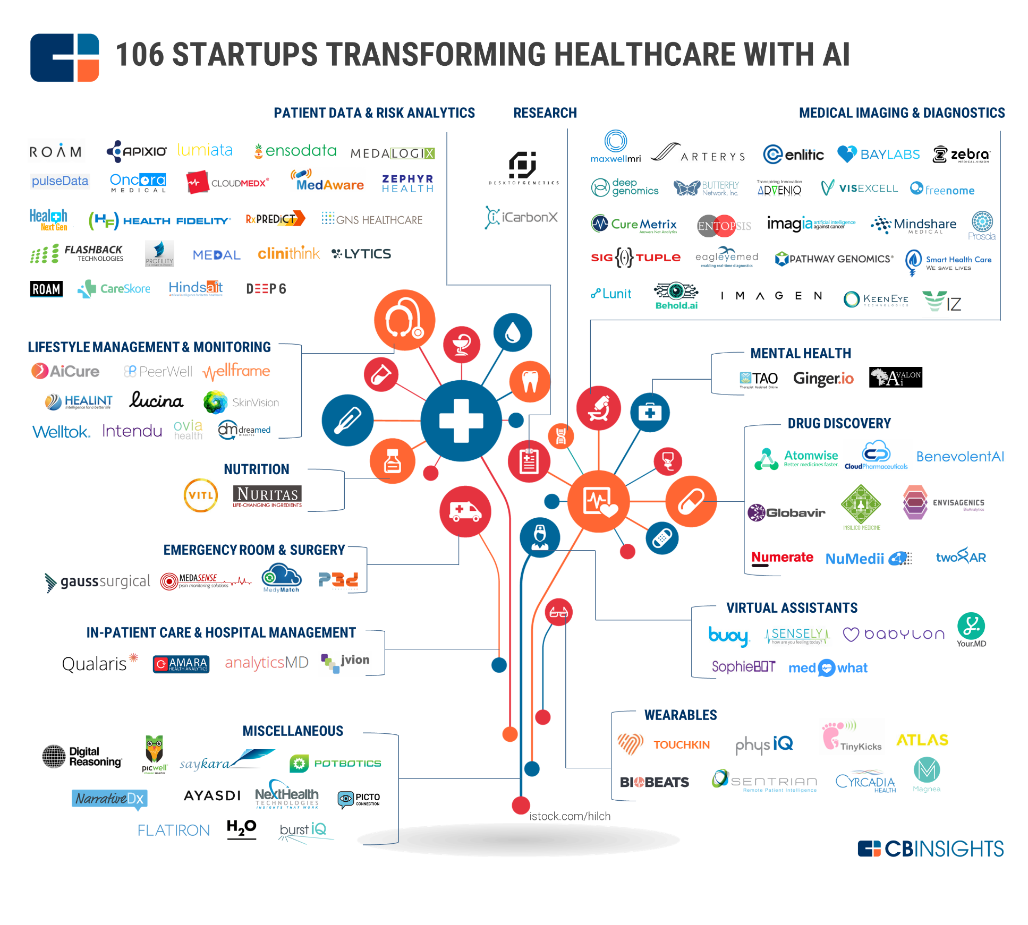
Applications of Machine Learning
Healthcare
ML
Source: cbinsights
Notes:
Explain how different branded healthcare companies have been using ML to revolutionize the Health Care industry. For eg: Health Fidelity uses machine learning to determine which medications, lab values, procedures, or comorbidities tend to pair with certain conditions, which can be used to generate rules that can identify potential gaps in chart documentation.

Slide 38
Now, you are able to explain:
The explosion of data has given rise to a new economy known as the data economy.
AI refers to the intelligence in machines that simulates human intelligence.
The capability of AI systems to learn by extracting patterns from data is known as machine learning.
Statistical machine learning uses the same math and techniques as data science.
Artificial intelligence and Machine learning are being increasingly used in various functions such as image processing, text analysis, healthcare, data mining, robotics, and video games.

Slide 39

©Simplilearn. All rights reserved

Slide 40
Machine Learning is ____________________
1
An autonomous acquisition of knowledge through the use of algorithms
An autonomous acquisition of knowledge through the use of manual programs
A selective acquisition of knowledge through the use of computer programs
A selective acquisition of knowledge through the use of manual programs

Slide 41
Machine Learning is ____________________
1
An autonomous acquisition of knowledge through the use of algorithms
An autonomous acquisition of knowledge through the use of manual programs
A selective acquisition of knowledge through the use of computer programs
A selective acquisition of knowledge through the use of manual programs
a . An autonomous acquisition of knowledge through the use of algorithms
Machine learning is an autonomous acquisition of knowledge through the use of algorithms.

Slide 42
What is the difference between traditional programming and machine learning?
2
Traditional programming is based on permutations and combinations, whereas machine learning uses traditional analytics.
Traditional programming considers output of the program to generate code, whereas machine learning uses data and program to generate output.
Traditional programming uses software programs, whereas machine learning uses hardware solutions.
Traditional programming uses hard-coded rules to make decisions, whereas machine learning learns from data.

Slide 43
What is the difference between traditional programming and machine learning?
2
Traditional programming is based on permutations and combinations, whereas machine learning uses traditional analytics.
Traditional programming considers output of the program to generate code, whereas machine learning uses data and program to generate output.
Traditional programming uses software programs, whereas machine learning uses hardware solutions.
Traditional programming uses hard-coded rules to make decisions, whereas machine learning learns from data.
d. Traditional programming uses hard-coded rules to make decisions, whereas machine learning learns from data.
Traditional programming uses hard-coded rules to make decisions, whereas machine learning learns from data by extracting patterns from it.

